Slide 2
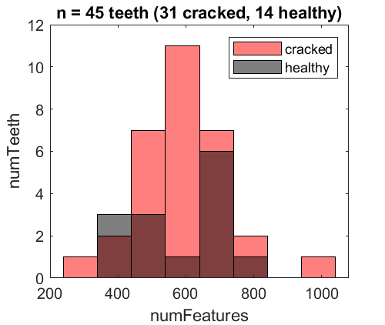
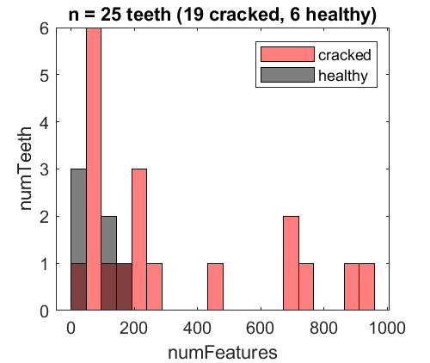
a
MicroCT
b
Hr-CBCT

Slide 3
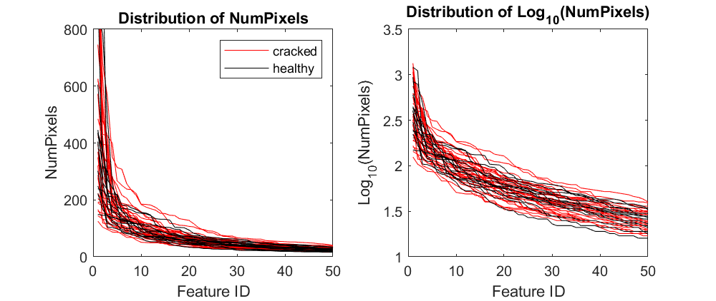
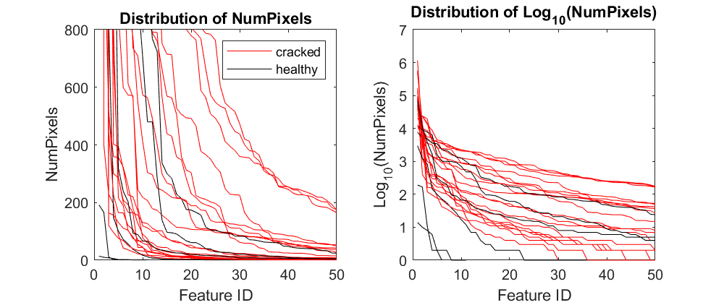
a
MicroCT
b
Hr-CBCT
Distribution of NumVoxels
Distribution of NumVoxels
NumVoxels
NumVoxels
Distribution of Log₁₀(NumVoxels)
Distribution of Log₁₀(NumVoxels)
Distribution of log10(NumVoxels)
Log₁₀(NumVoxels)
Log₁₀(NumVoxels)

Slide 4
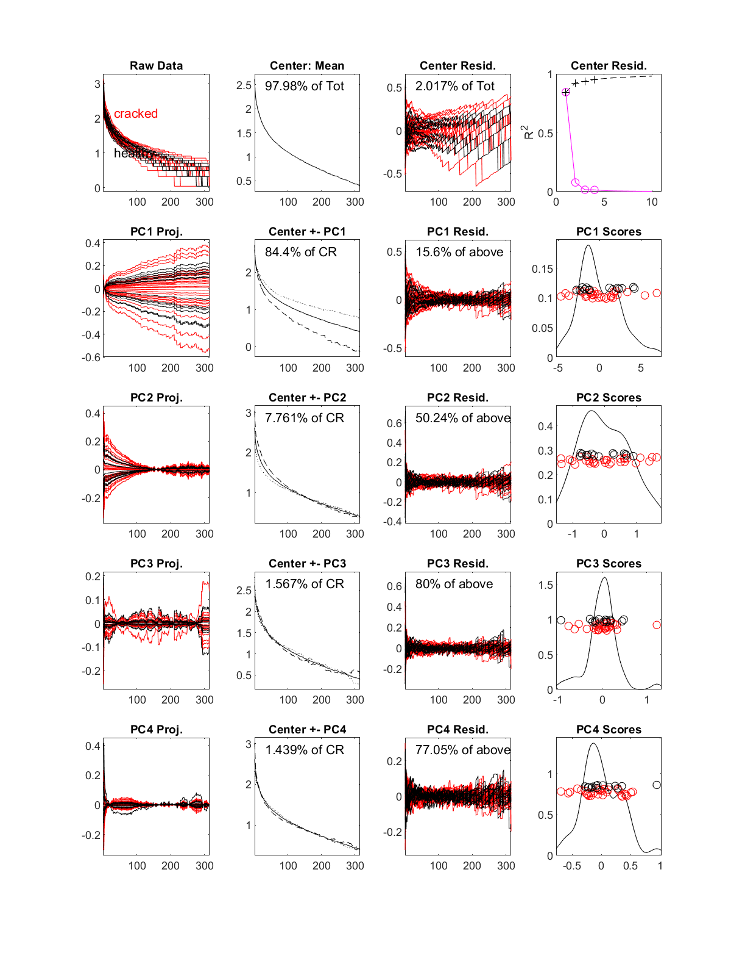
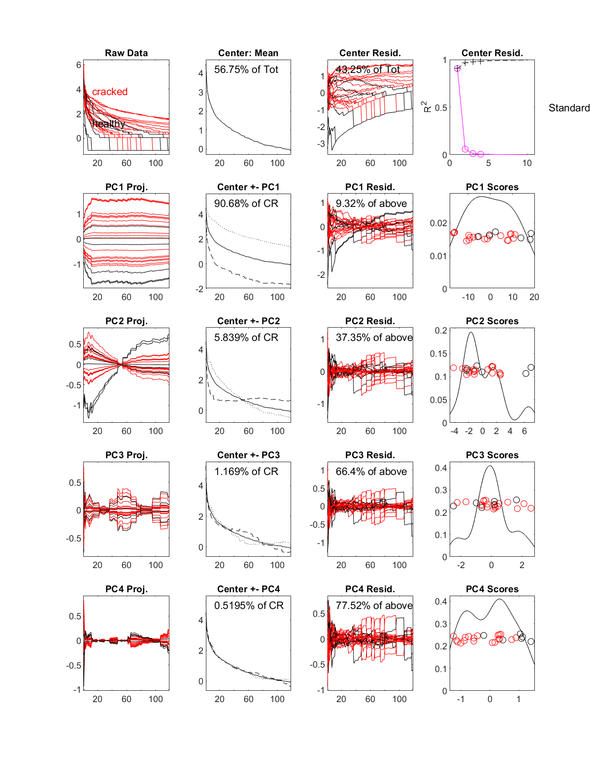
a
MicroCT
b
Hr-CBCT
Log₁₀(data)
Log₁₀(data)

Slide 5
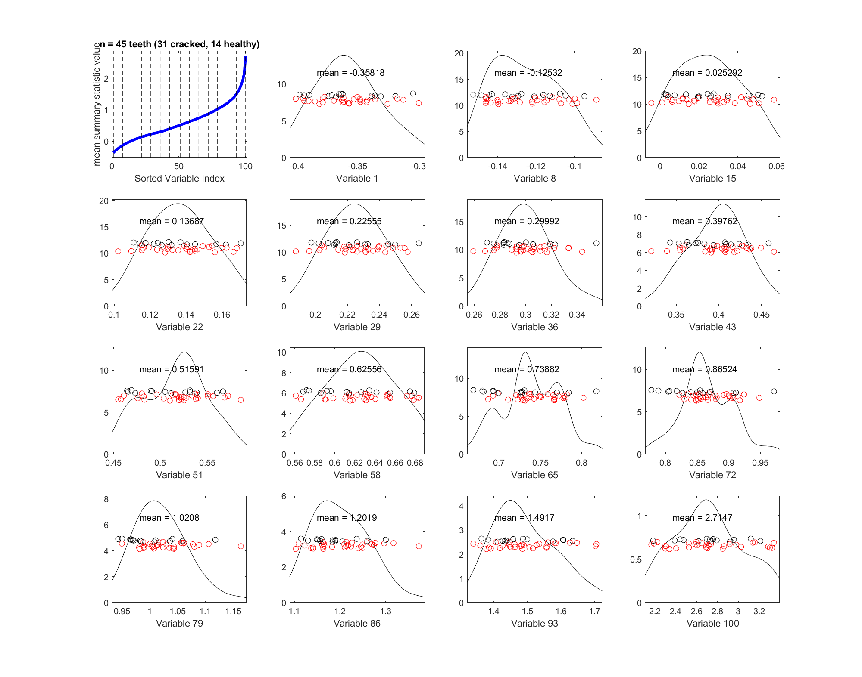
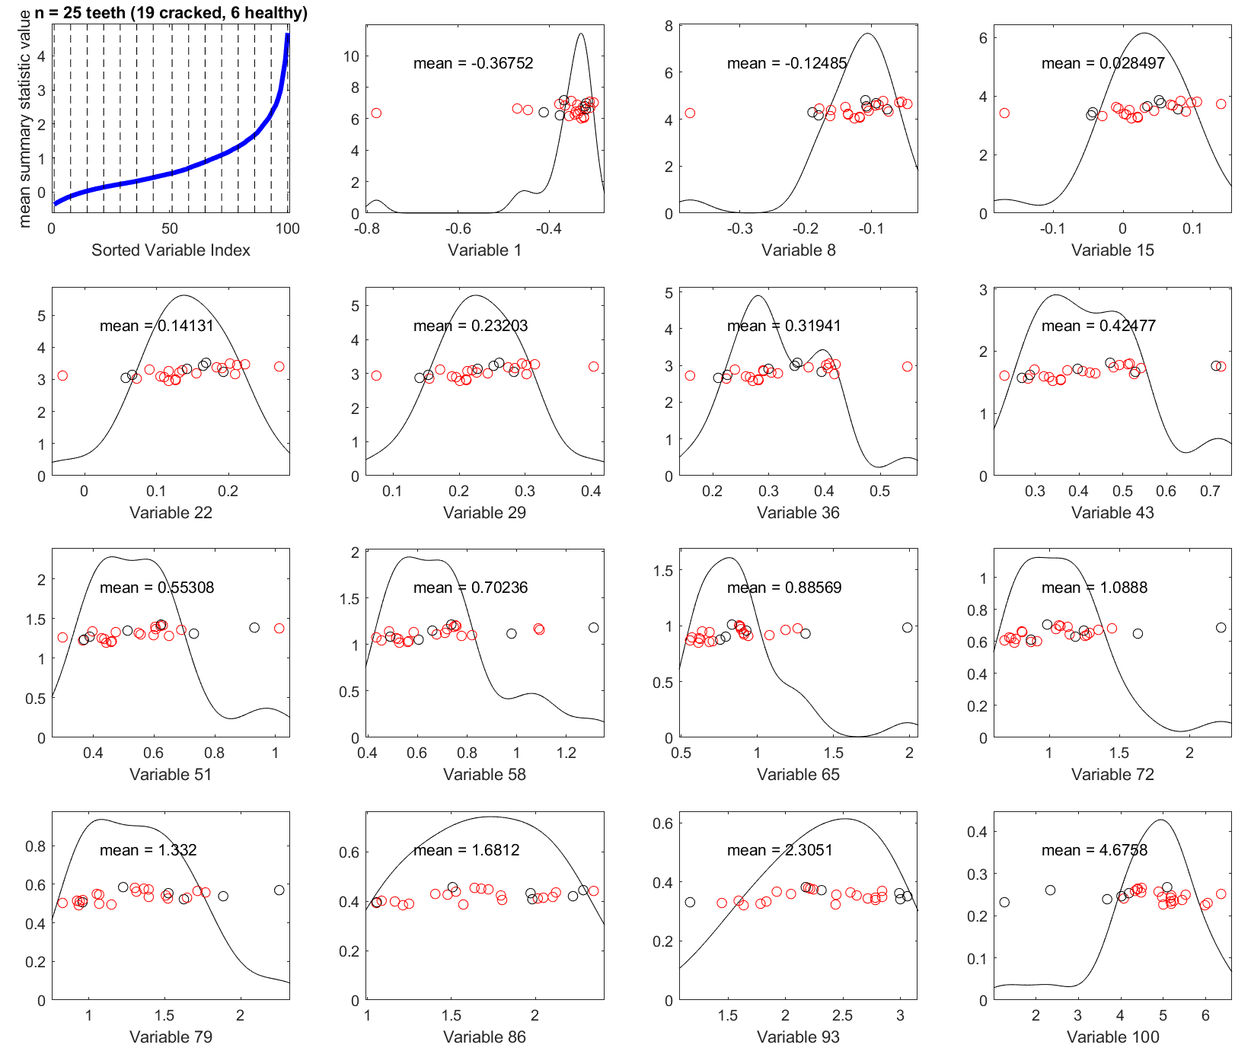
a
MicroCT
b
Hr-CBCT

Slide 6
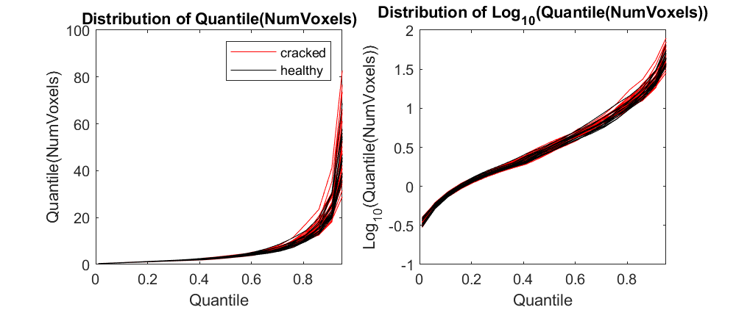
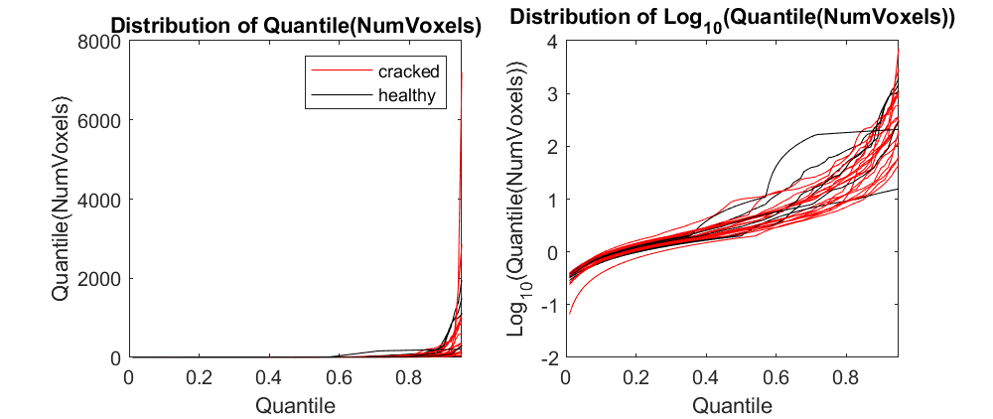
a
MicroCT
b
Hr-CBCT

Slide 7
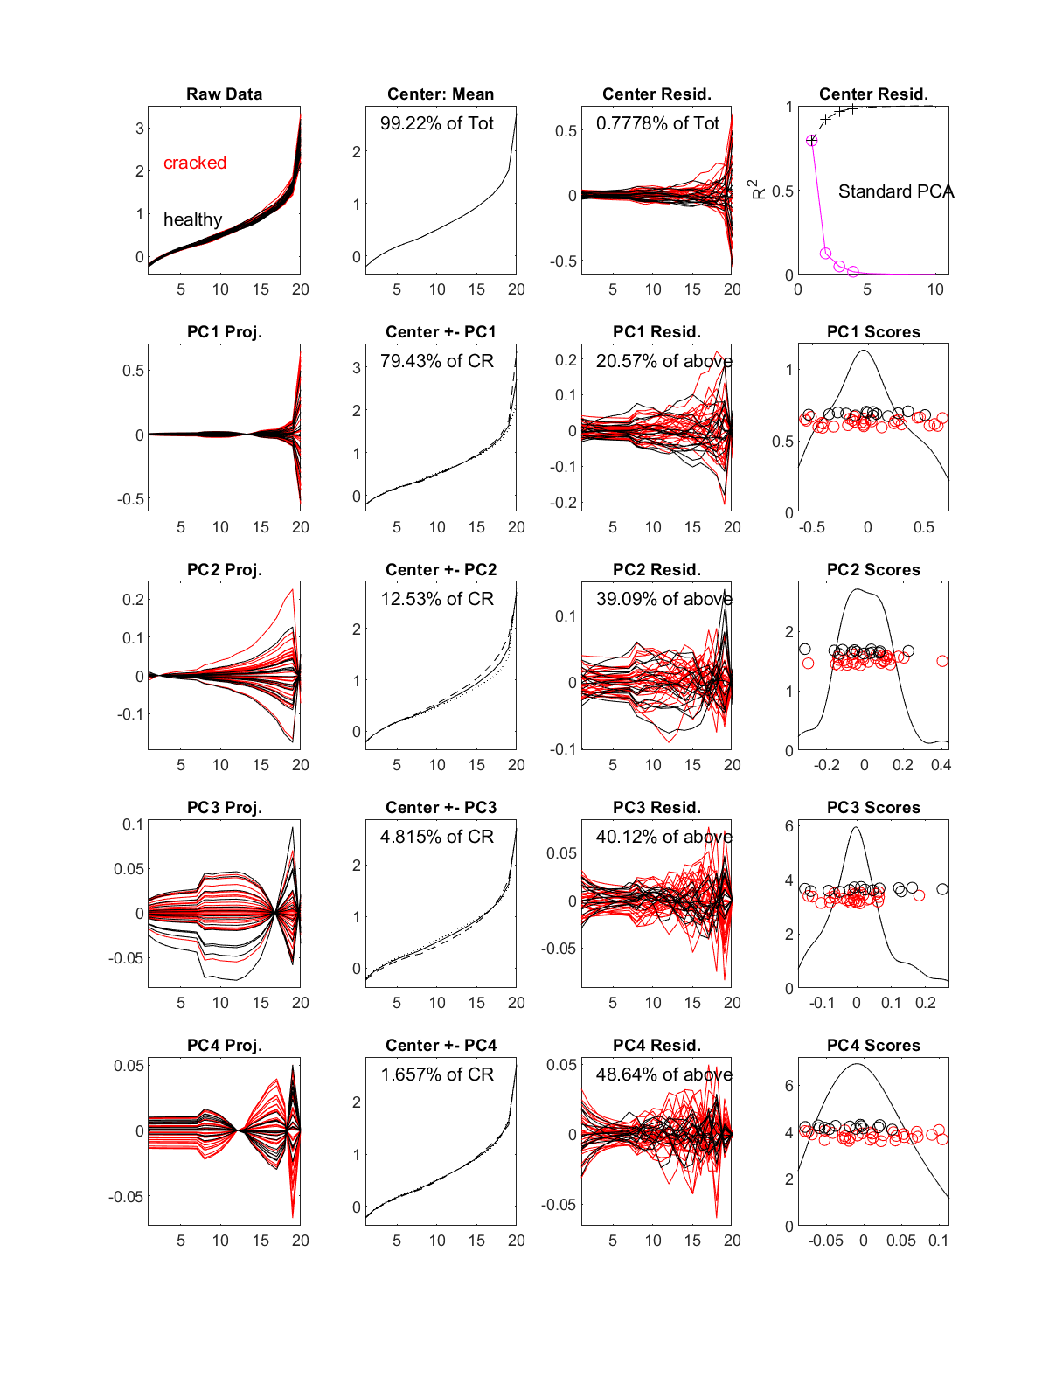
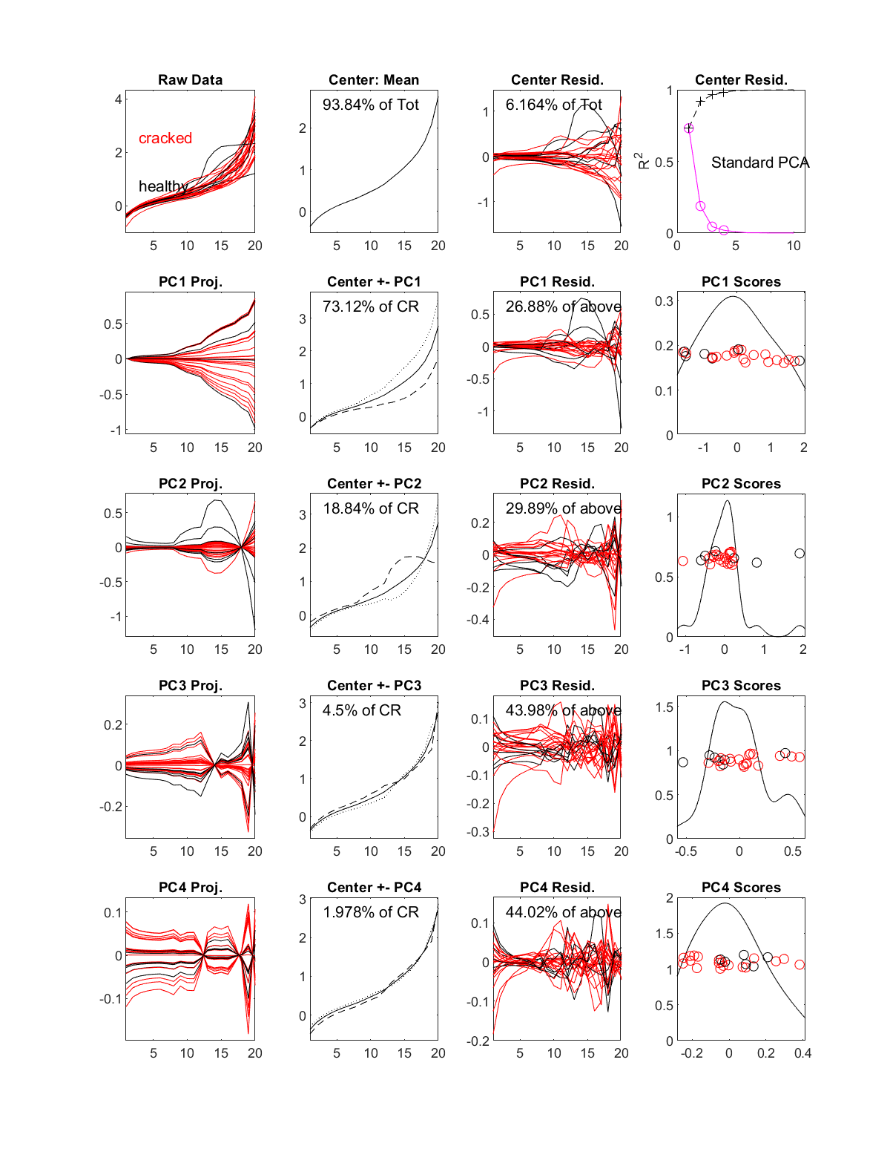
a
MicroCT
b
Hr-CBCT
Log₁₀(quantile)
Log₁₀(quantile)

Slide 8
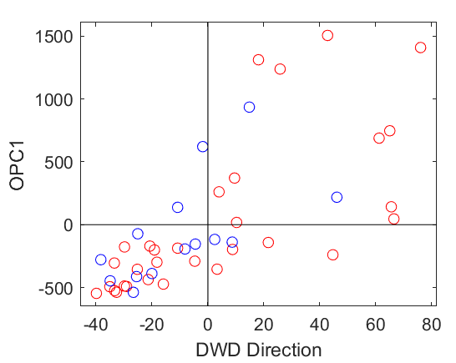
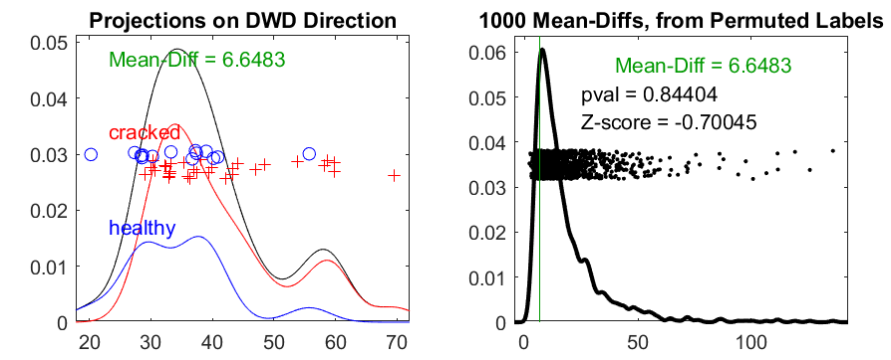
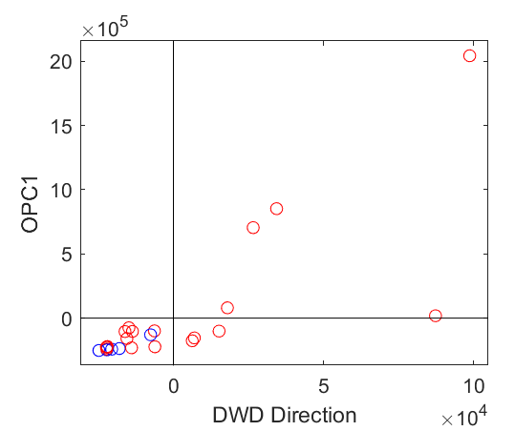
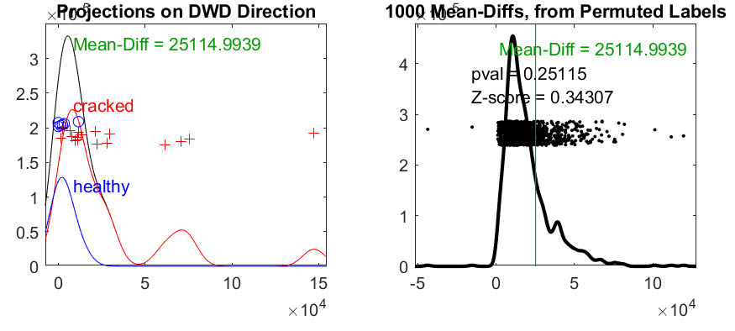
a
b
DWD classification for microCT
c
d
DWD classification for hr-CBCT

